Slide 1
Booking appointment

Slide 2
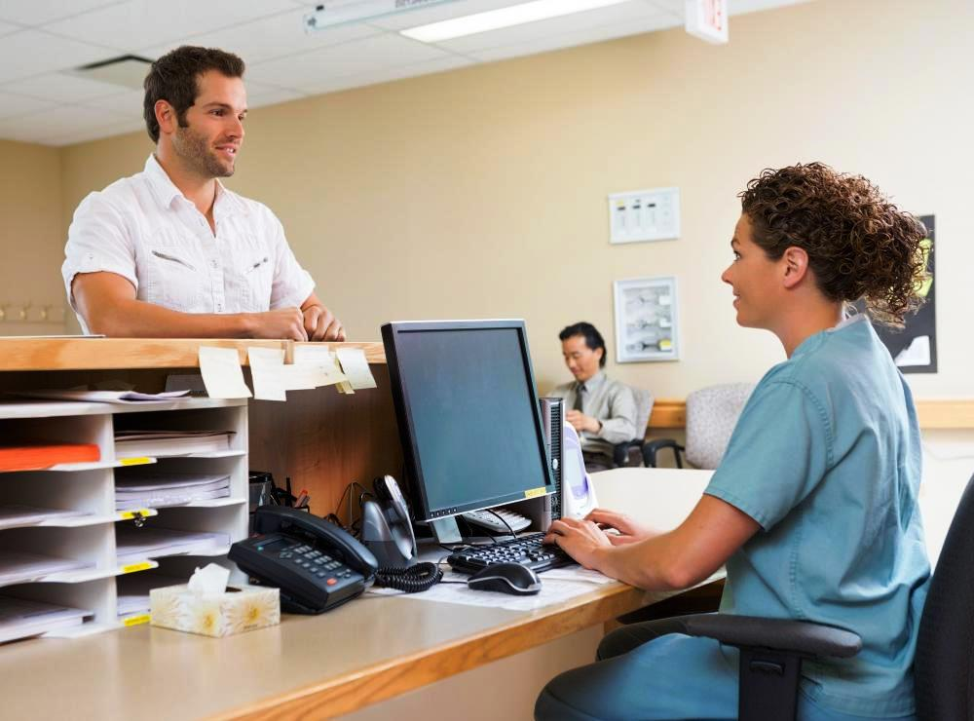

Step 1:
Step 2:
The patient Jason Watson meets with booking clerk and makes entire schedule for his therapy treatment.
(Retrieved from http://images.wisegeek.com/woman-in-scrubs-working-at-computer-near-counter-and-man.jpg)
The patient Jason Watson has Skin Cancer and he’s referred to the radiotherapy in BCCA.

Slide 3
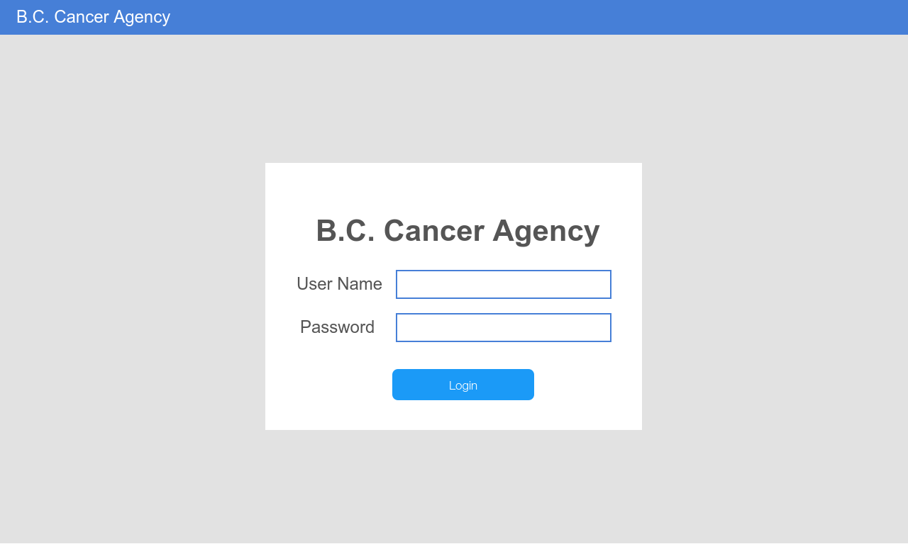
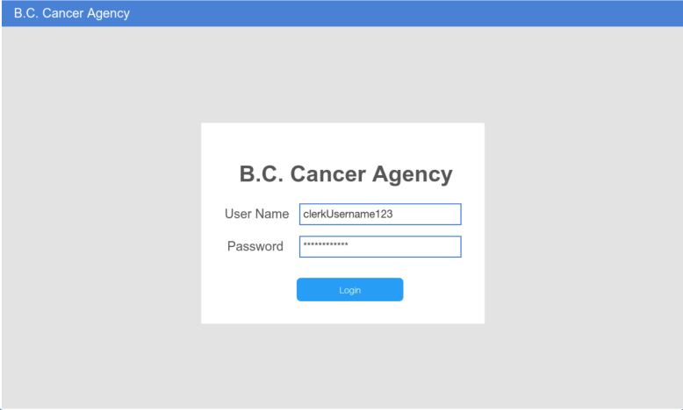
Step 3:
The booking clerk logs in to the system with assigned username and password.

Slide 4
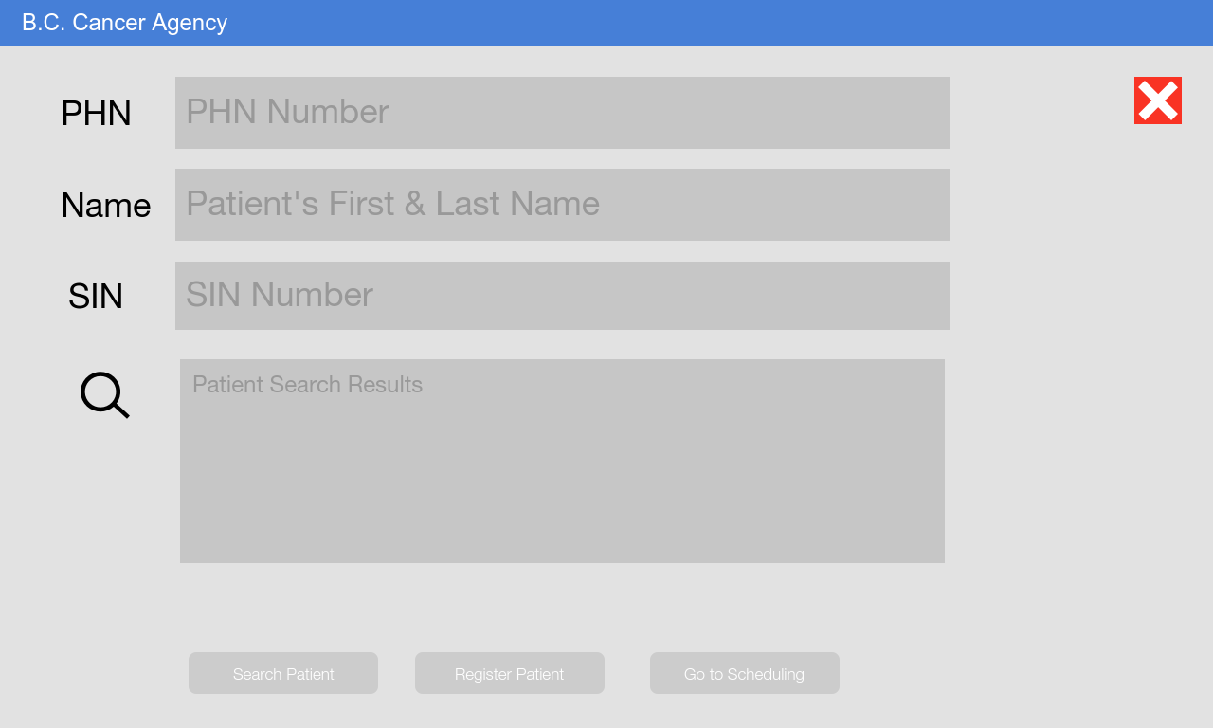
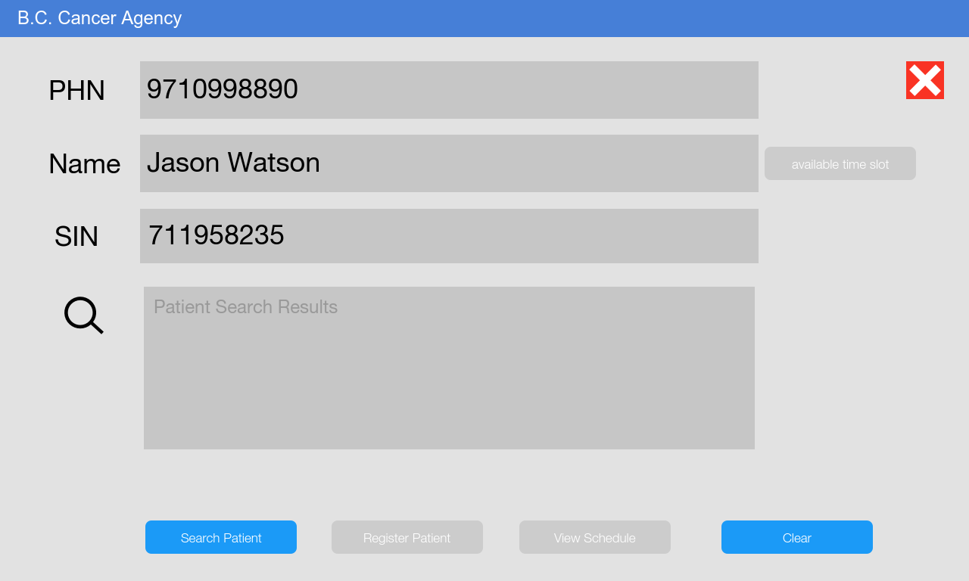
Step 4:
The booking clerk asks the patient for name, PHN number or SIN. Jason Watson provides the information and then, the booking clerk searches in the system to check whether the patient is already in the system.

Slide 5
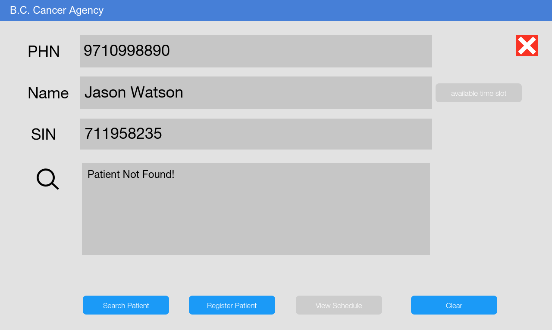
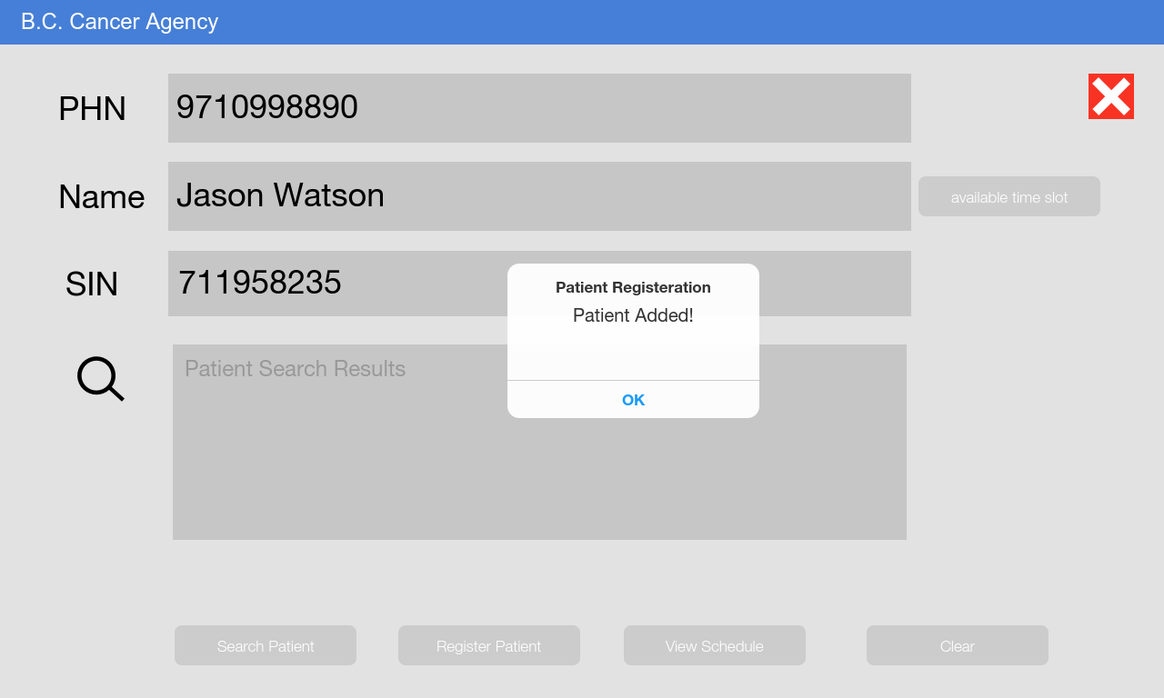
Step 5:
The system shows the patient Jason Watson is not in the system. The booking clerk clicks on the “Register Patient” button. A pop-up box shows on the screen and informs the clerk that the patient is now registered in the system. The booking clerk clicks OK button.

Slide 6
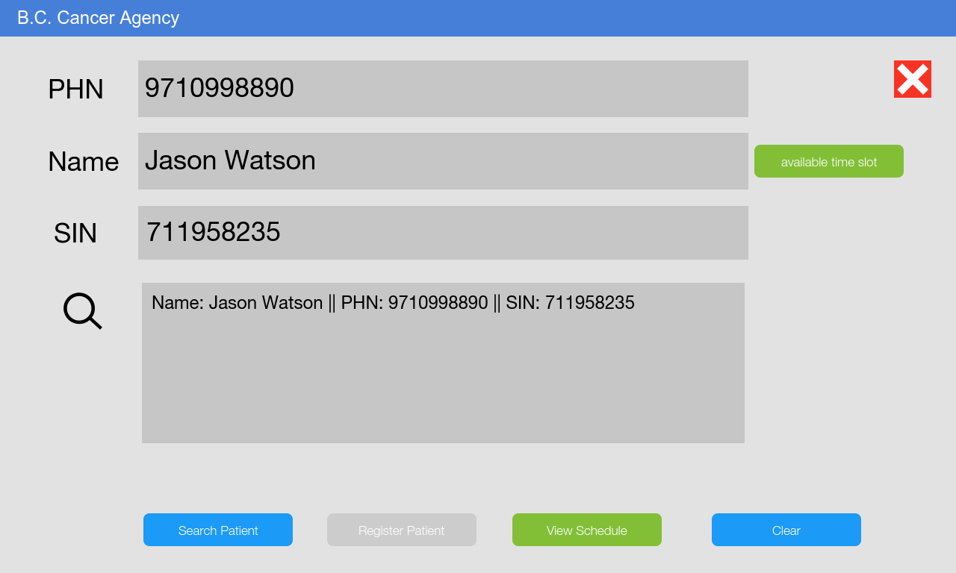
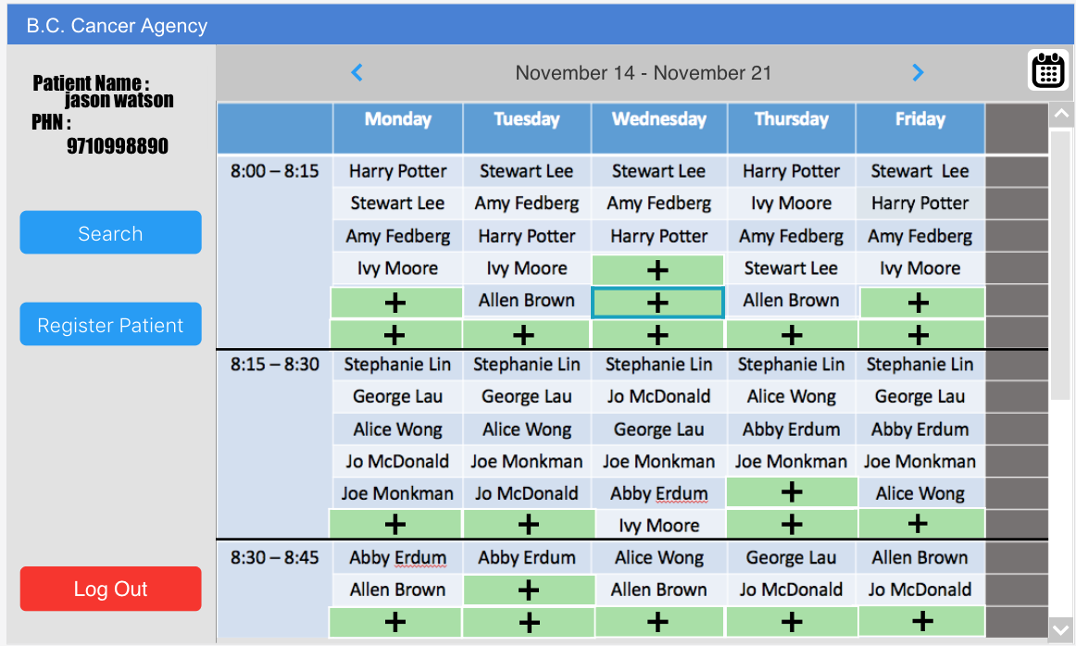
Step 6:
The booking clerk clicks the “available time slot” button, the page switches to a patient view, with the specific patient name and available time slots. Jason tells the clerk the preferred time slots.

Slide 7
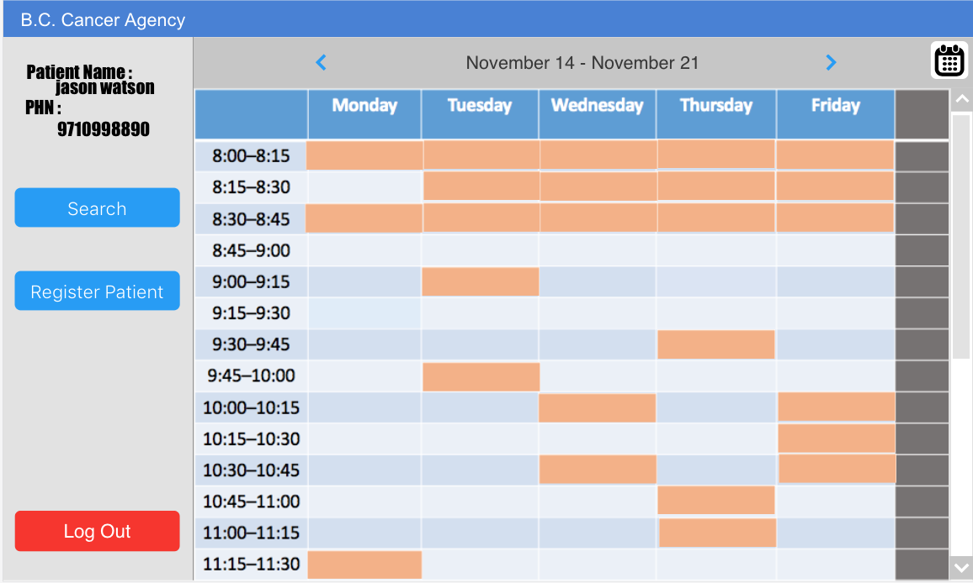
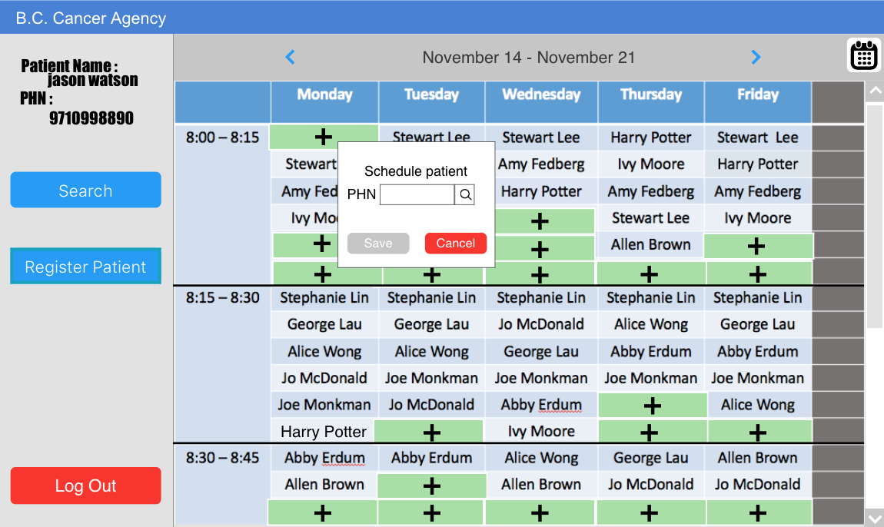
Step 7:
------->
patient’s screen
Jason Watson sees the orange colored slots which means there’s at least one machine left as empty time slots and chooses the time spots which are available for him.
------->
clerk’s screen

Slide 8
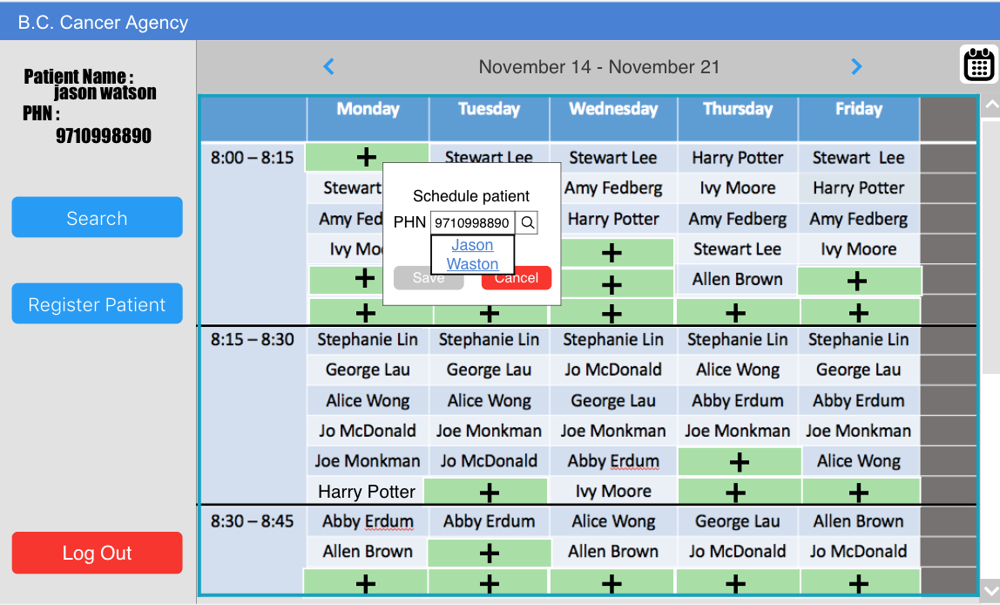
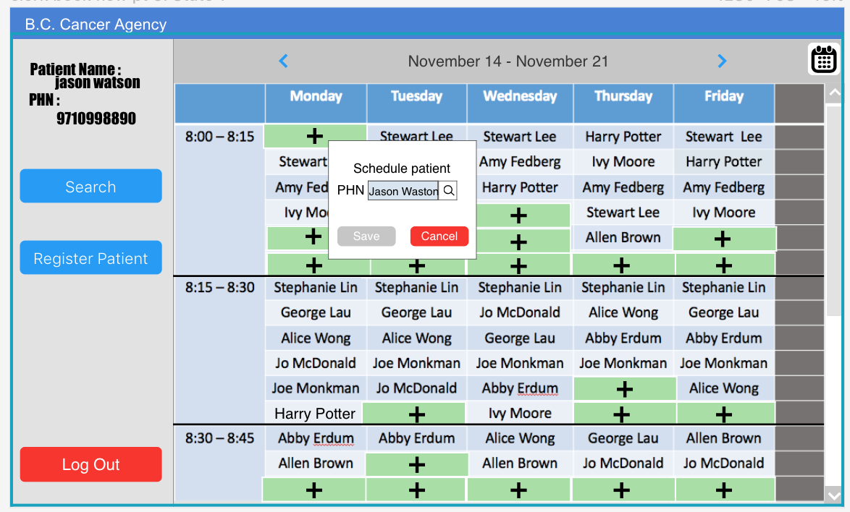
Step 8:
The booking clerk clicks the empty spots which is available for Jason Watson. The booking clerk enters Jason’s PHN and clicks his name.

Slide 9
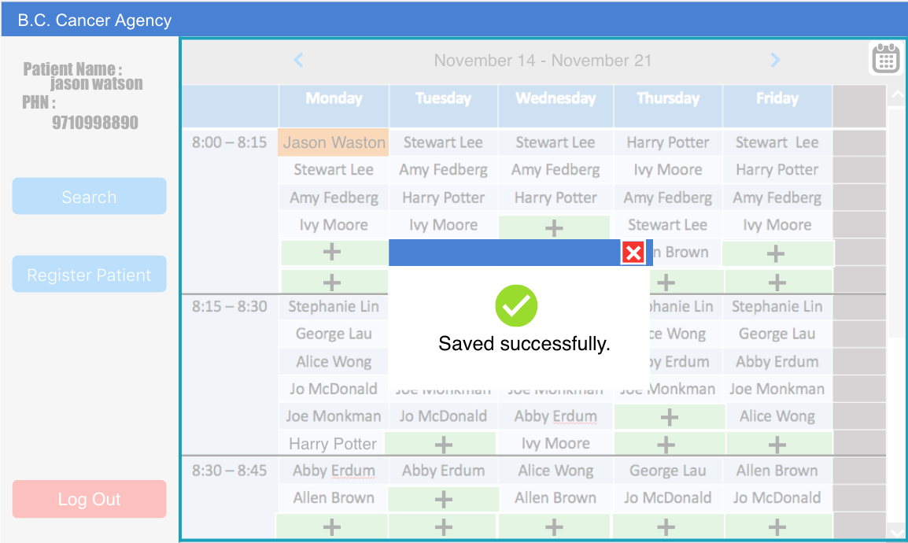
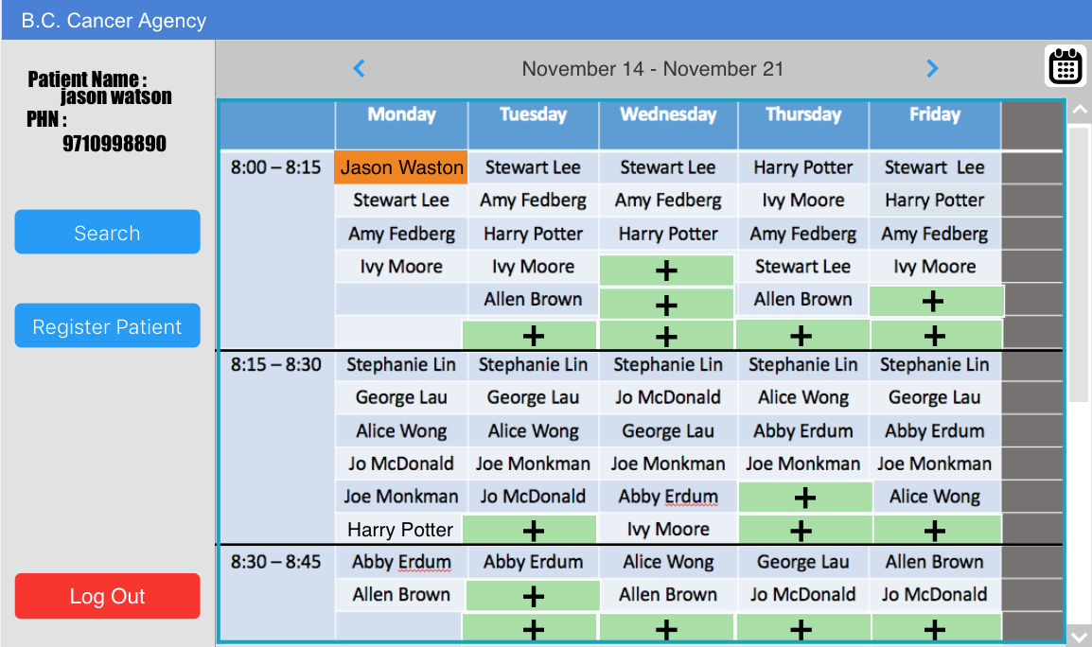
Step 9:
The booking clerk clicks “save” button and a pop-up box shows “saved successfully” appears on the screen. The system has been updated with Jason’s name in the time slot. After Jason books his schedule on Monday, there’s no “add” button for Monday’s all free time slots in order to prevent double booking. An email about all the Jason’s appointments will be sent.

Slide 10
Assigning roles

Slide 11

Step 1:
The administrator wants to add the role for a new clerk Amy Wong. The administrator logs in the system. A list of staffs shows on the screen with Amy Wong’s name on it.

Slide 12
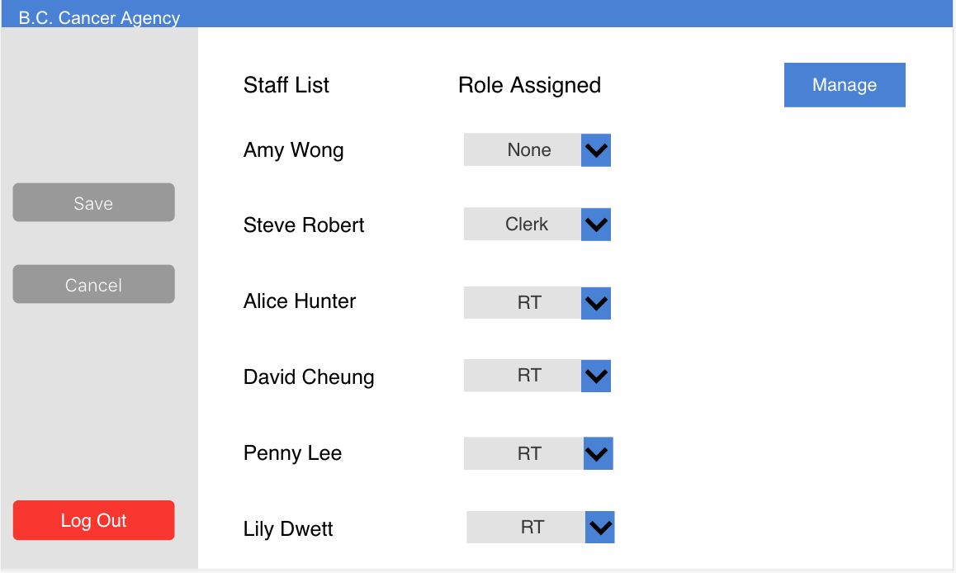
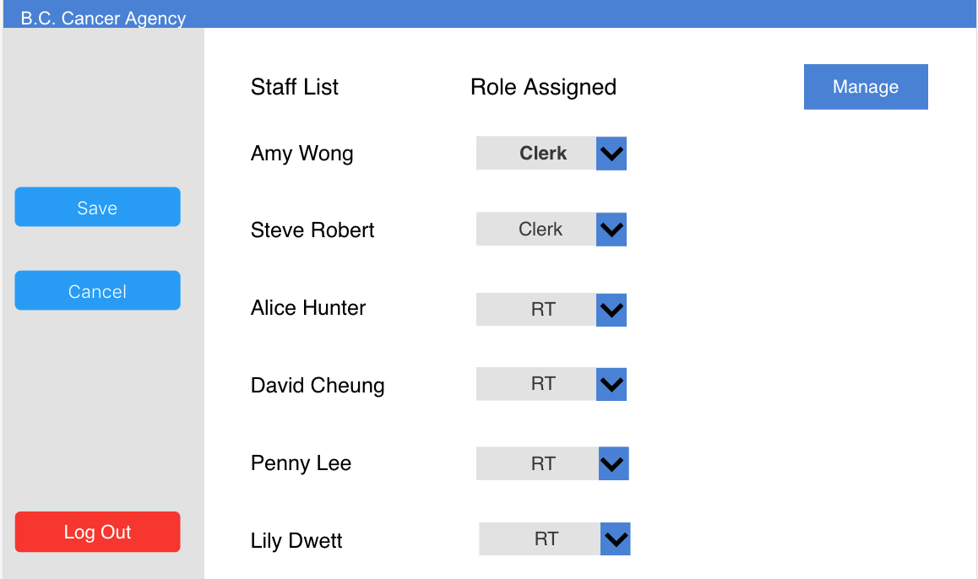
Step 2
The administrator selects “clerk” as Amy Wong’s role.

Slide 13
RT view schedule

Slide 14

Step 1:
The patient Harry Potter comes for treatment with the RT. After they finish the treatment, RT wants to check Harry Potter’s next appointment time.
retrieved from http://www.healthitoutcomes.com/doc/the-importance-of-patient-engagement-and-technology-0001

Slide 15

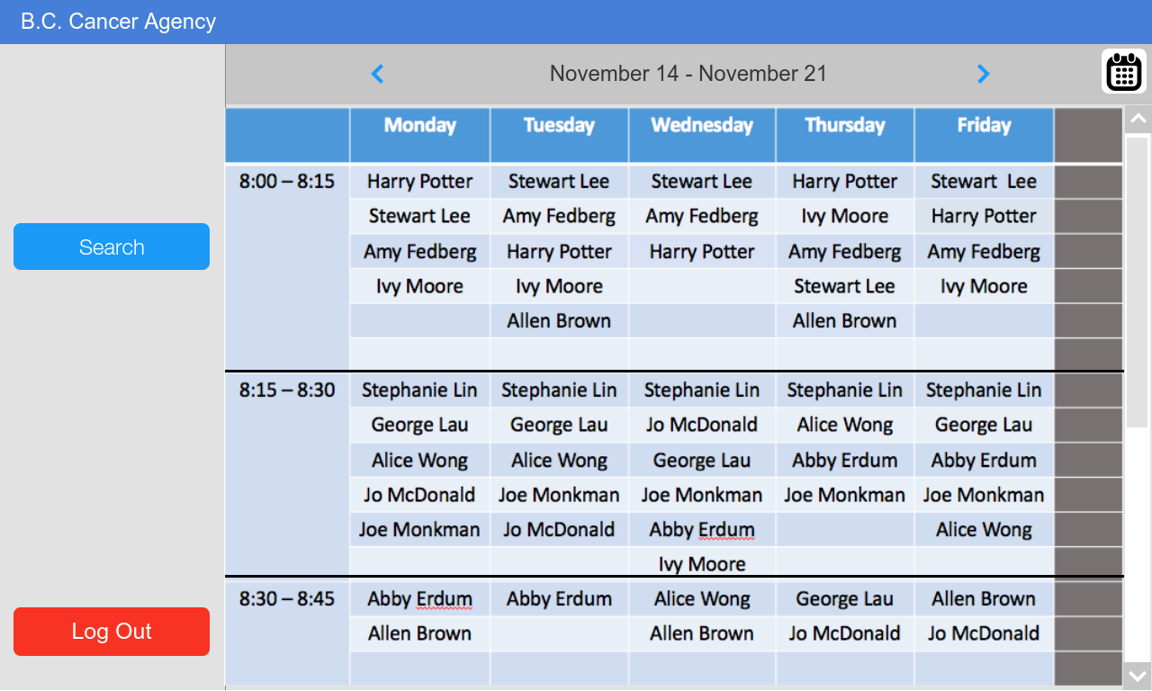
Step 2:
RT logs in the system and views the entire schedule for all the patients in the week.

Slide 16
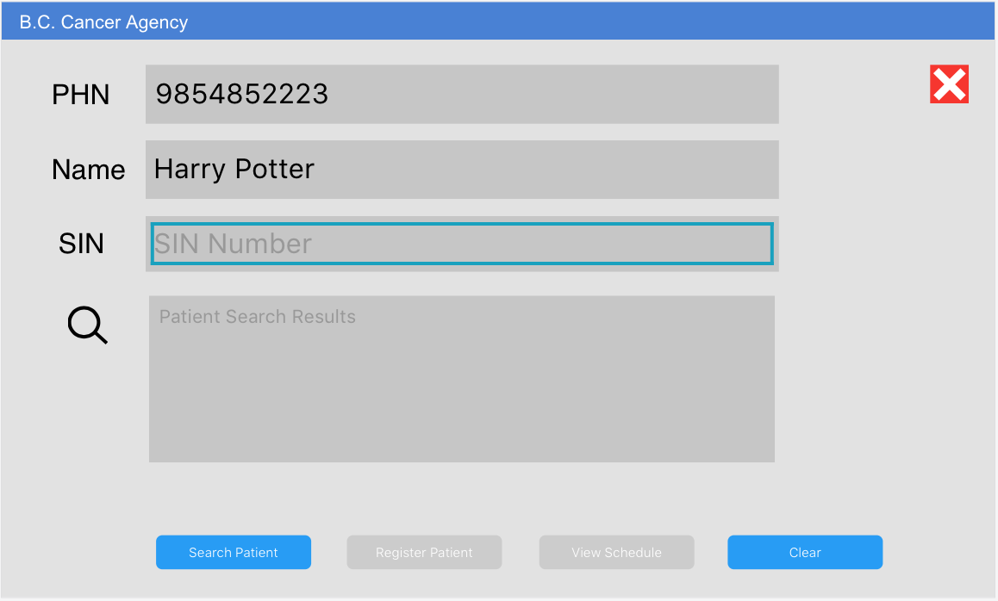
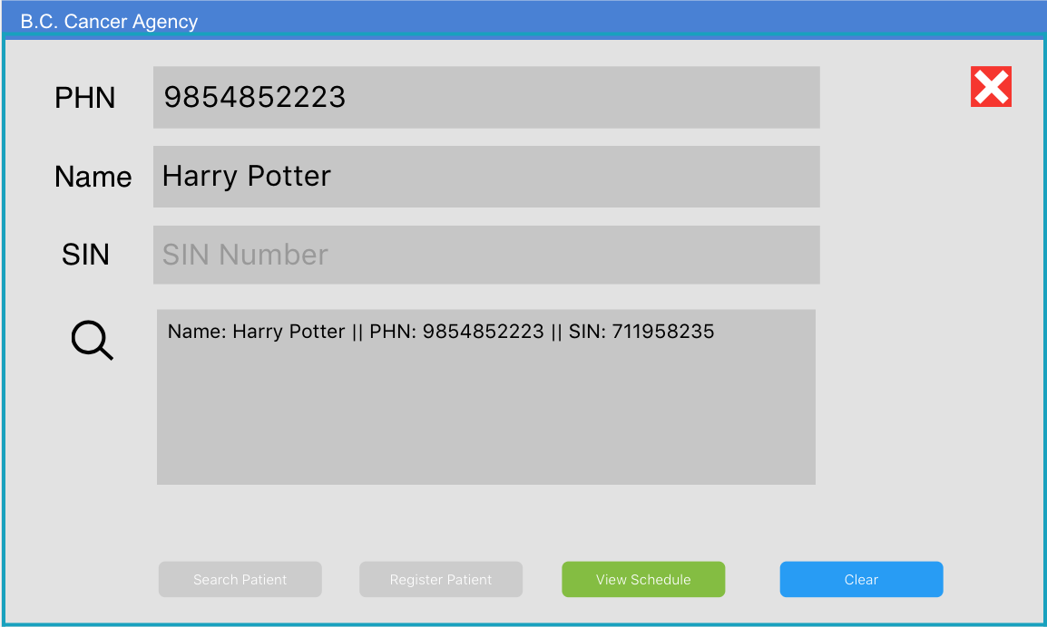
Step 3:
The RT clicks on the “Search” button to find Harry Potter and clicks on “View Schedule” button.

Slide 17
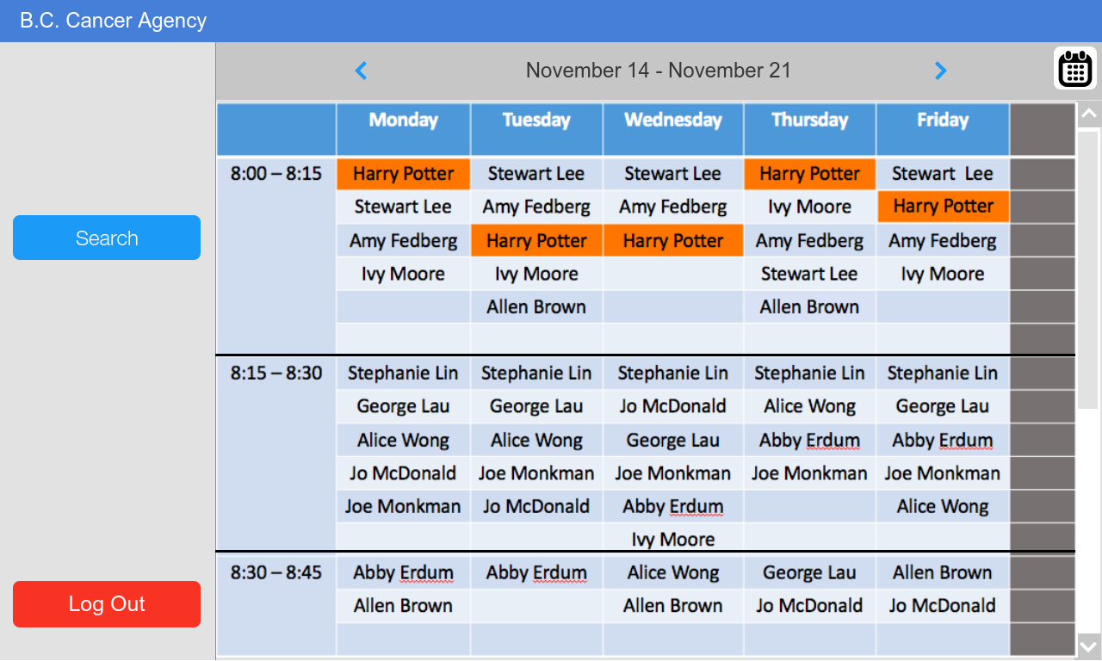
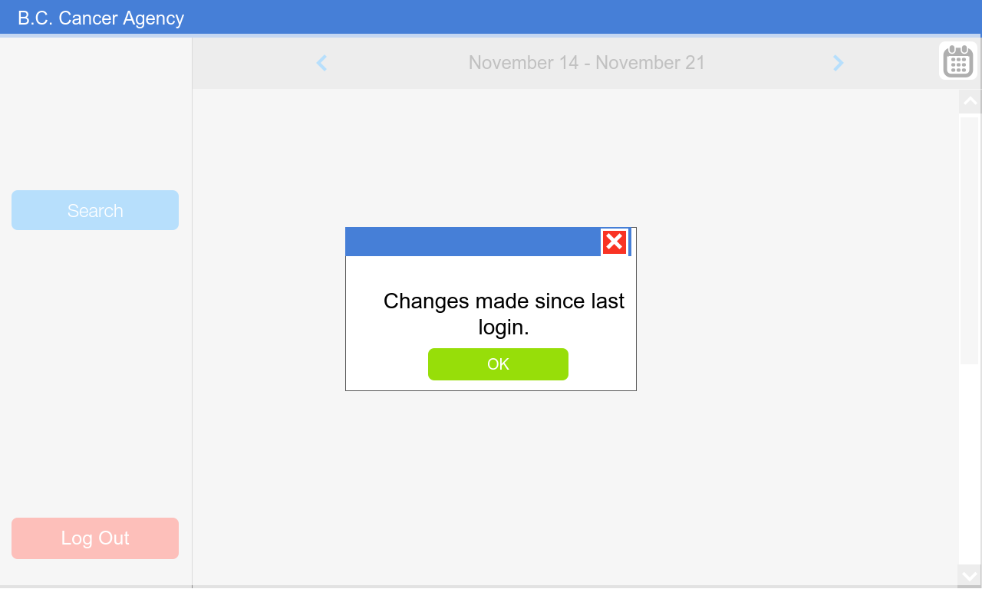
Step 4:
The time slots with Harry Potter’s name in are highlighted. The RT refreshes the screen to check whether there’s any change to the schedule by booking clerk when RT is viewing it.

Slide 18
Rescheduling

Slide 19
Step 1:
A patient called Harry Potter needs to reschedule his appointment on the following Monday. He walks into BCCA and requests rescheduling to booking clerk.
(Retrieved from http://images.wisegeek.com/woman-in-scrubs-working-at-computer-near-counter-and-man.jpg)

Slide 20
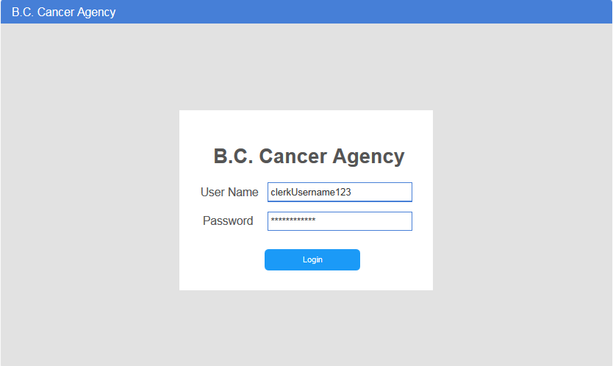
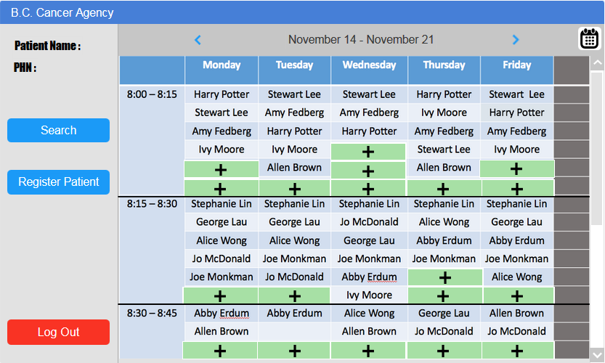
Step 2: Step 3:
The clerk logs in the system with assigned username and password.
The clerk is brought to the main view of the system. Clerk clicks on the “Search” button.

Slide 21
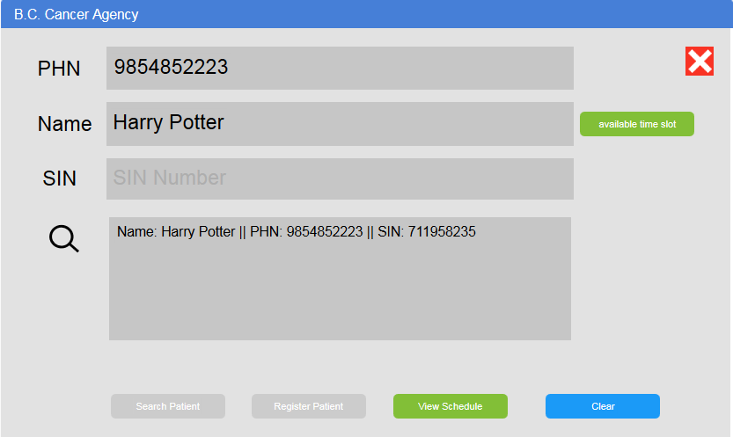
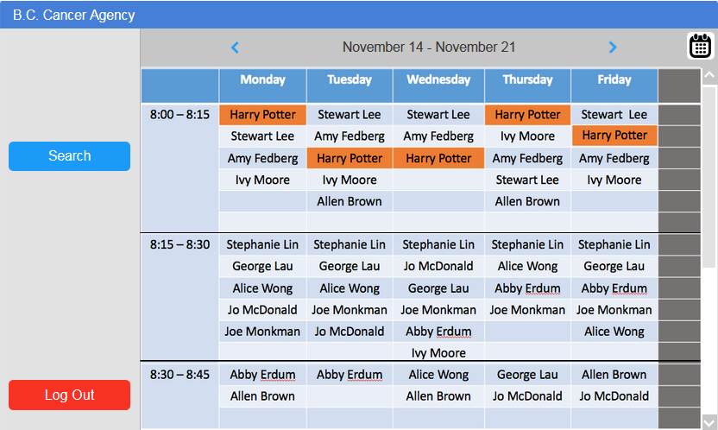
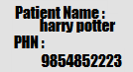
Step 4:
After confirming he is in the system, the booking clerk clicks on “view schedule” to see highlighted schedules of this Harry Potter.

Slide 22
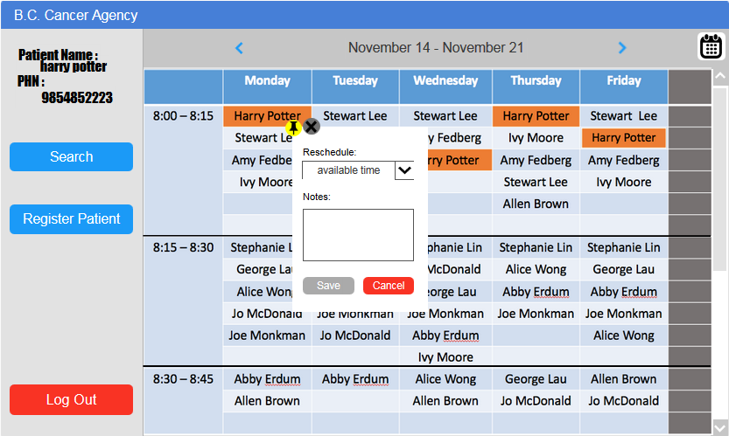
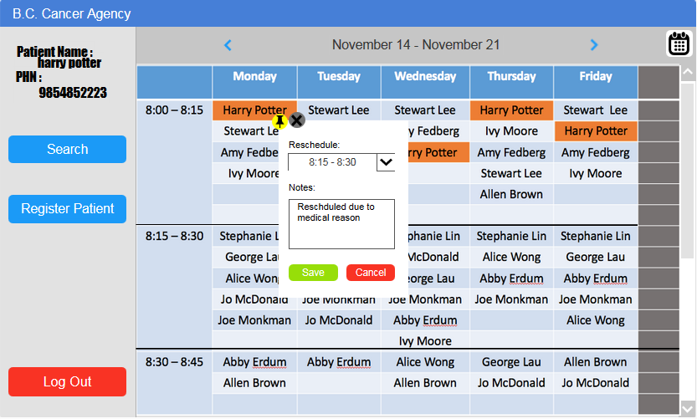
Step 5:
The booking clerk clicks on the “edit” button to reschedule. Only available time slots in the system shows up. The booking clerk asks Harry’s preference for existing time slot, and saves the result.

Slide 23
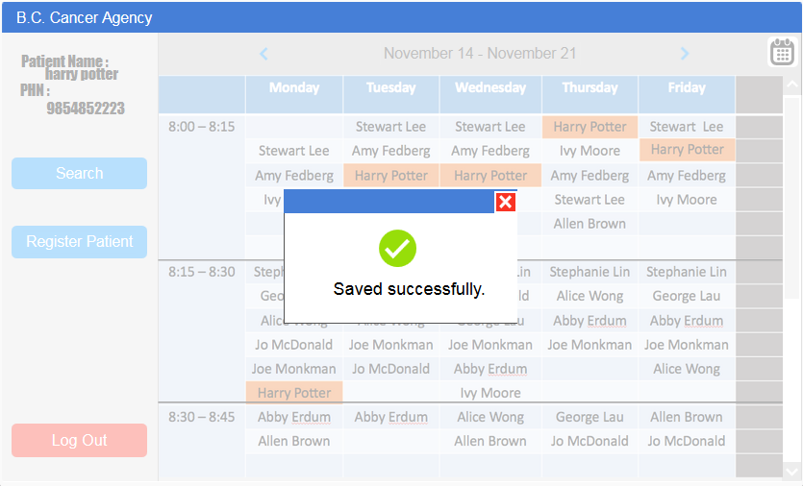
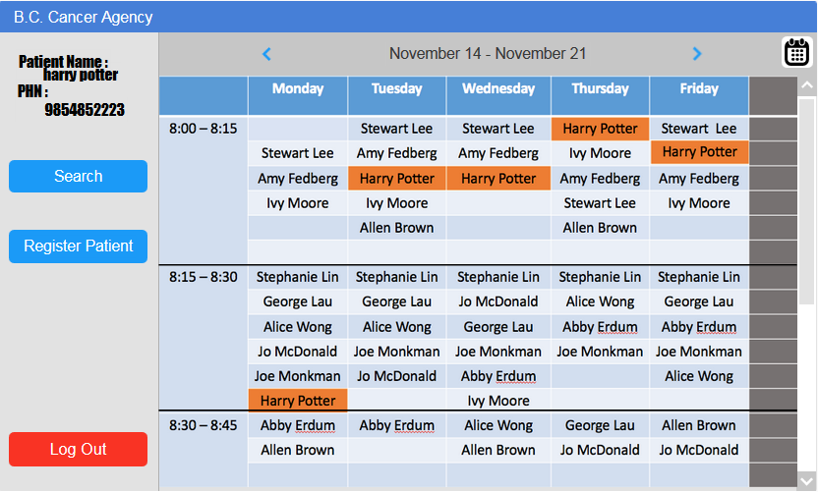
Step 6:
After saving, Harry Potter’s appointment on Monday is successfully switched to 8:15 - 8:30. An email about the change will be sent to patient automatically.

